Slide 1




Heelal Technology
Let lawyers be lawyers again.
+852 6502 9706
kaidrian@heelal.biz

Slide 2

The prospect of AI: globally and in HK
We are entering the age of strong AI (or AGI, artificial general intelligence)
In China, AGI researchers and companies are still nearly non-existent. This may have to do with Chinese culture’s aversion to innovation and originality and the rigid structure of China’s higher education system
One question is whether China should develop its own advanced technology or collaborate with other nations. This question becomes acute in view of the current US-China conflict
Hong Kong is China’s window to the outside world, uniquely positioned to foster international collaboration on frontier AI research
As entry-point we choose the legal market

Slide 3

Legal Market
The most document intensive industry in the world
Global legal service market growth rate: 4.5% per year
Global legal market size: $1 trillion USD in 2021
E-discovery market alone: $12.5 billion USD

Slide 4
Reasonable
Old Document Management Systems
Ample storage space
Third party tool integration
Cloud integration
Mobile device integration
Price
Not pretty, but acceptable
Features
MANUAL!!!
User Interface
Functioning

Slide 5

Problem Definition

Slide 6
Our solution
An intelligent search engine
powered by
state-of-the-art NLP technology
Notes:
1

Slide 7
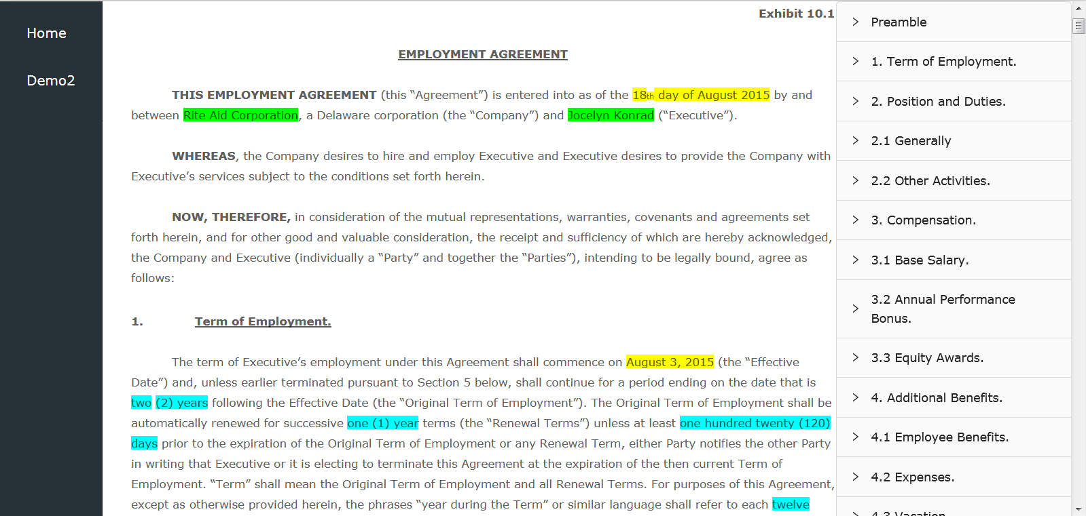
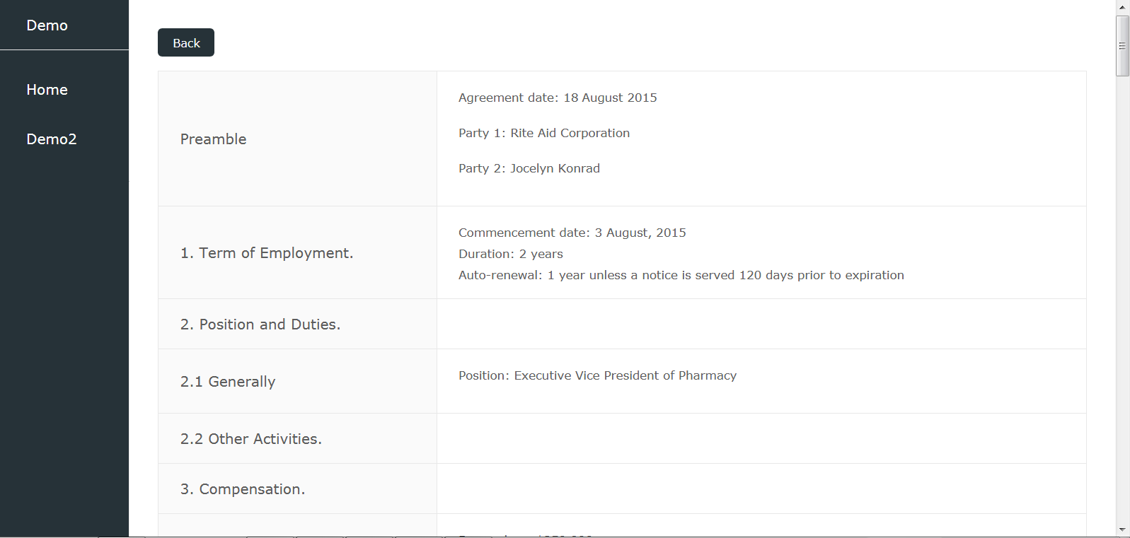
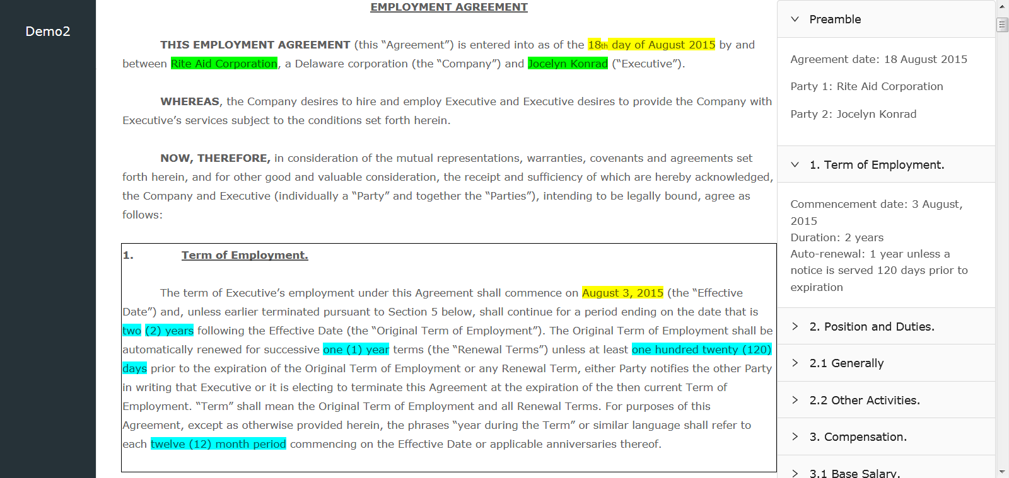
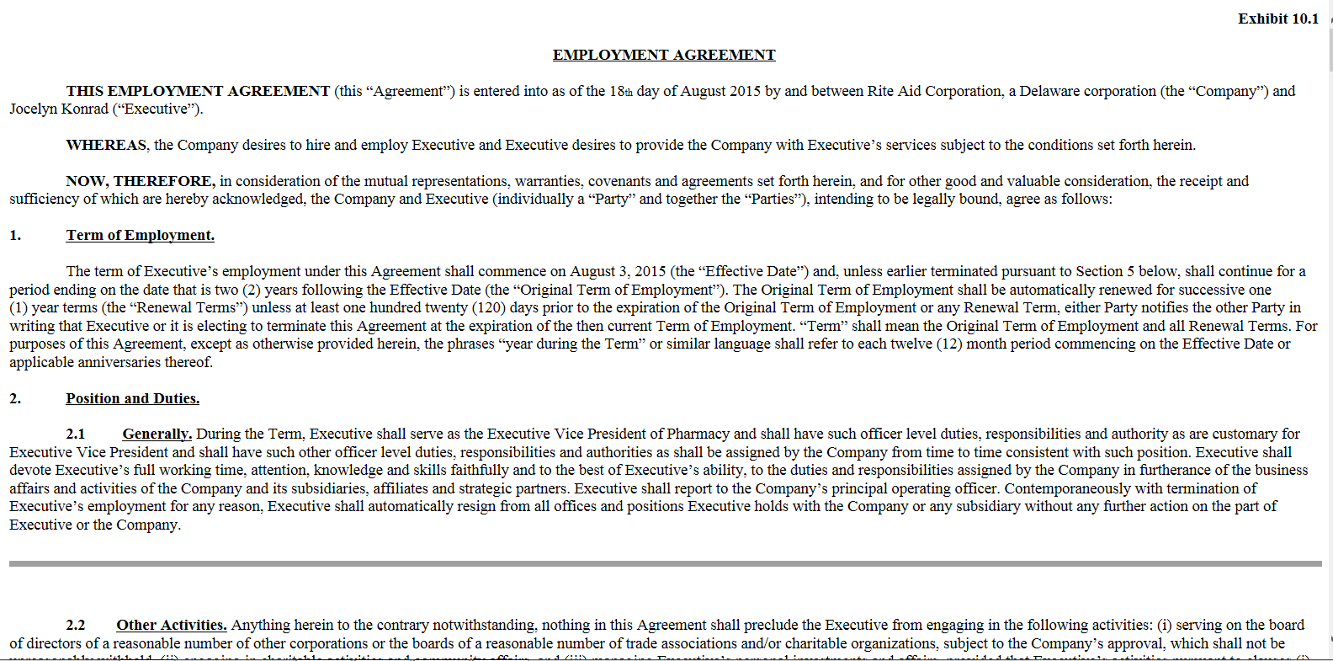
Identify. Summarize. Extract.

Slide 8
End-to-End Enterprise Software
Team Collaboration
Boost boost, transparency
Project Management
Streamline work processes
A.I
Contract Review
Automatically identify, summarize, extract, speeding up review process
Knowledge Management
Enable smart, versatile searches

Slide 9
Competitors
Team Collaboration
Email, Outlook
Project Management
Email, Outlook
A.I
Contract Review
Luminance (US $23M), Kira System (US $50M), ebrevia (US $4.3)
Knowledge Management
Logikcull (US $25M), CsDisco (US $135M)
Notes:
1

Slide 10
Competitive Advantage
Last year we also applied to this programme, but at that time we were still in the “blue-sky research” stage
This year has seen significant breakthrough, where our theory has yielded algorithms, algorithms led to successful proof-of-concept code, and we are confident to deliver commercializable software within 3-6 months
Many local AI startups borrow other people’s technology, with in-house R&D at an insignificant level
Our original research provides the framework for long-term development with virutally no end in sight... which is like a seed that may lead to exponential growth
If successful, our company will provide jobs for the vast untapped talent pool of China’s AI researchers, students, amateurs
Notes:
1

Slide 11
Thank you!

Slide 12
Extra

Slide 13
1
Our Team & Partners

Slide 14

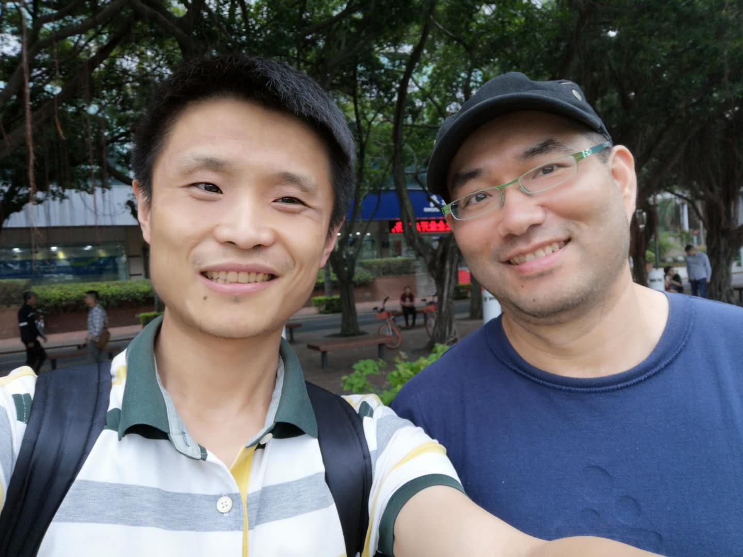
Partners
北京 彩云科技specializes in NLP, translation, weather forecast, etc.
Dr肖达, 清华大学，北京邮电大学 教授, 彩云科技chief scientist One of the few researchers interested in AGI in mainland China We have been discussing AGI for several years
彩云科技has been developing their own BERT-like models since the advent of BERT
We are now working together on the initial training of Logic BERT
Possible future collaboration in advanced NLP

Slide 15
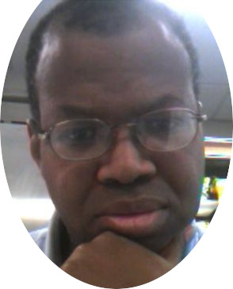


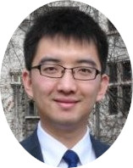

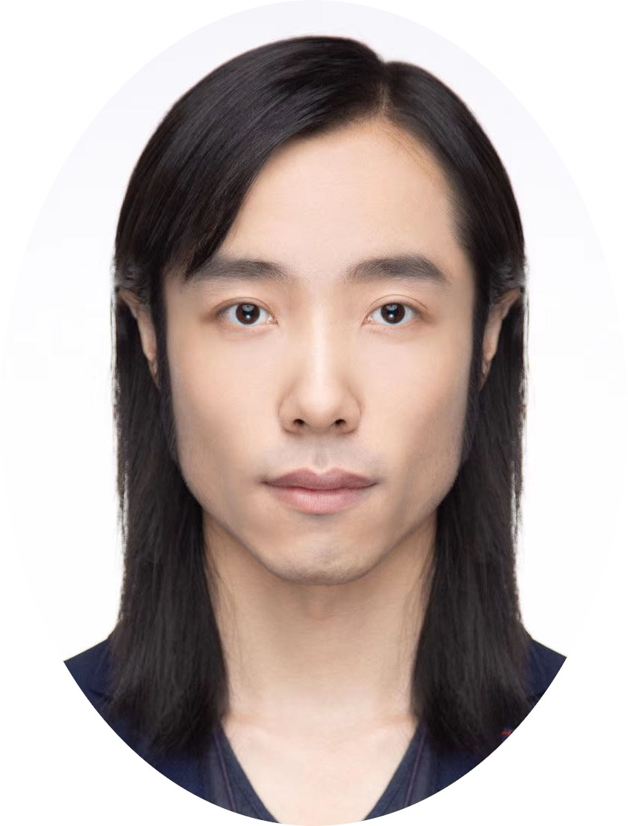

Our Team
(remote member) William H Taylor Binghamton Univ, NY, USA AGI researcher, creative writing
(potential candidate) 陈代超，北大undergrad Long-time friend and researcher interested in AGI
Ben Yu, Univ of Chicago AI entrepreneur, finance, data science
Kaidrian Yu, HK CityU Lawyer, entrepreneur
叶安, 桂林电子科技大学 Researcher Machine vision, NLP
Pete Tang, CUHK MSc Machine learning, data scientist
Yan King Yin CUHK, Hofstra, NY USA AGI researcher

Slide 16
2
Technology

Slide 17
Technology
Please refer to our technical documents:
“The Logic Route to Strong AI” (main article)
“Logic BERT” (supplement 1)
“AI and the Structure of Logic” (supplement 2)

Slide 18
3
Development Plan

Slide 19
Development Plan
Third Stage (2021 Q1 onwards)
First Stage (Now – 2020 end)
Second Stage (2020 Q4 – 2021 Q1)
Customer acquisition
Continue R&D improvement
Logic BERT (coding and training)
Knowledge-graph database
Legal documents processing and annotation
User interface design
Train ML algorithms on more diverse dataset to suit more use cases
Market testing

